Slide 1
XPath
Service-Oriented Software Engineering
Software Institute
Nanjing University
Bei Jia

Slide 2
Example Tree Representation of XML

Slide 3
XPath Current Context
The active element within the XPath address step
  /Root/.../Ancestor/Parent/SELF/Child/Descendant

Slide 4
Partitioning the Document
Self, ancestor, descendant, preceding and following partition the entire document

Slide 5
XPath Step Syntax
An XPath location path is made up of one or more steps separated by a forward slash ("/").
Each step within the path consists of:
  Axis: Branch of the node tree relative to the current context node
  NodeTest: Tests node for inclusion
  Predicate: Optional filter of matched nodes
Example:
  Locate all chapters titles in the book that contain the string 'XPath'

Slide 6
The Thirteen Axes

Slide 7
XPath Axis Node Type and Node Tests

Slide 8
Abbreviated Step Notation
The following step abbreviations may be used to simplify XPath location paths

Slide 9
Sample Node Tests
//comment()
  Extract all comments from a document
/book/*/title
  Extract all top-level titles regardless of parent type (that is, Chapter, Appendix, and so forth)
/processing-instruction()
  Extract all Processing Instructions that exist outside of the root element
/book/chapter[2]//text()
  Extract the actual text from all elements inside the second chapter
chapter/section[2][@status="Draft"]
  Extract the second section child of every chapter child of the context node where the section status attribute has a value of "Draft"

Slide 10
Predicates (1/2)
All comparisons or function calls are within the predicate, enclosed within [ ]
Predicates test a set of nodes and return one of:
  A new set of nodes
  A string
  A boolean
  A number
Each node in the list of nodes is tested to see if the predicate is true
  If predicate is true the node is included in the resulting list of nodes
If a predicate results in no matching nodes, an empty result set is returned

Slide 11
Predicates (2/2)
Predicate expression types
  Function call
  Number
  Literal
  Location path
Extra logic operators can be used inside a predicate
  Allows boolean “and” and “or” chaining of tests
Math operators allowed in predicates for numbers
  Equality “ = ” operator
  Less than “ < ” and Greater than “ > ” operators
  Other functions

Slide 12
Predicate Core Functions

Slide 13
Predicate String Functions (1/2)

Slide 14
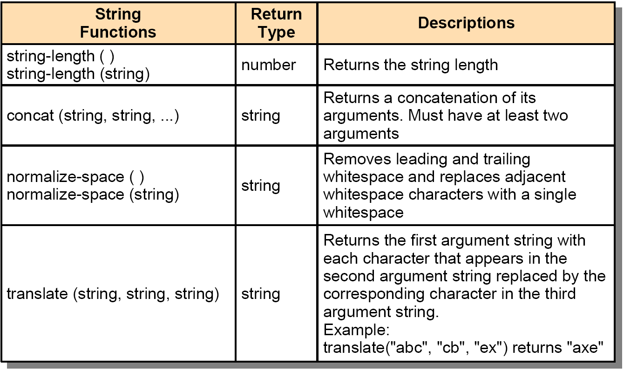
Predicate String Functions (2/2)

Slide 15
Predicate Number and Boolean Functions

Slide 16
Example: Absolute Addressing

Slide 17
Example:
Absolute Addressing with Predicates

Slide 18
Example: Relative Addressing

Slide 19
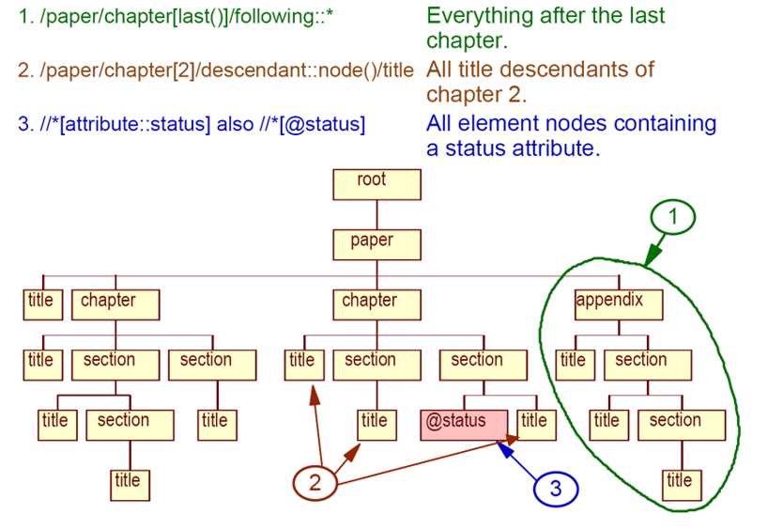
Example: Addressing with Axes

Slide 20
Reference Information

